Slide 1


AGENDA
Version Control Git intro
GitHub intro

Slide 2
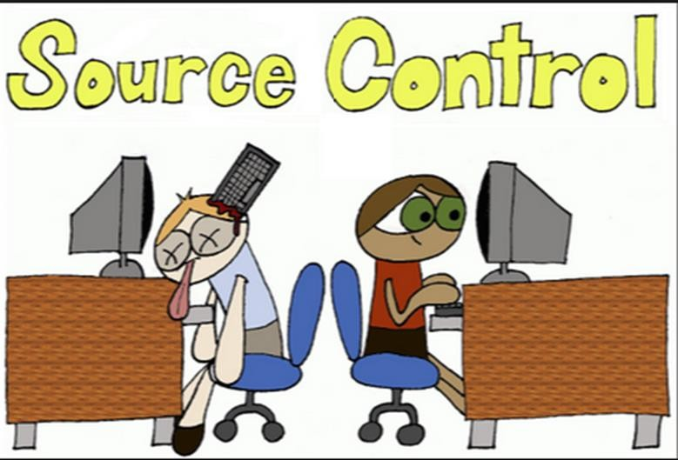

Slide 3
What is Version Control?
Aka “Source Control”
Keeps track of your creative output
It tracks what is changed
It tracks who made the change
It tracks why changes were made

Slide 4
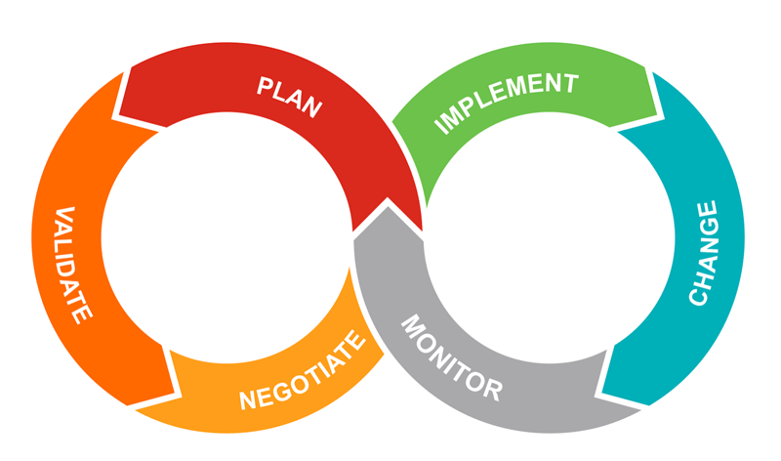
Why Version Control?
Content
Teams
Agility
Supports many workflows:
collaboration
team review
communication
Manages small changes
Easy testing (new ideas)
Easy fix or undo changes
Complete history of the project is trackable and available at any time

Slide 5
Who needs it?
Who is it for?
Developers/ designers
Writers/ producers /Artists / composers
What do it use it for?
Source code, scripts, images, icons, style sheets
Novels, screenplays, spreadsheets, music
Alone, or with team

Slide 6
Big Idea - Collaboration
Team Benefits
Synchronization
Accountability
Conflict Detection
Social Coding - open source projects

Slide 7
It will let you deliver different versions of the product (Continuous Improvement)
Removing bug
Adding feature

Slide 8
Vocabulary – general terminology
repository - your tracked project, repo
main (used to be master) - baseline repository
check-in - combining your work with master
check-out - updating your local work with latest files from master
Notes:
-repo is just simply the project folder

Slide 9


AGENDA
Version Control Git intro
GitHub intro

Slide 10
What is “git” ?
“Distributed version control”
Free, open source (2005, Linus Torvalds)
Command-line tool
Runs on all OS’s
Efficient, simple, distributed, scalable, “light”

Slide 11
Git manages versions of the project
Each version called a commit. (even a small change)
Each commit is a new snapshot of the entire project.
Removing bug
Commit A version with a bug
20 files
Commit B
version without a bug
20 files but one changed

Slide 12
Behind the scene, git is very efficient in storing commits (versions)
Each unique file is stored only once
Removing bug
Commit A version with a bug
20 files
20 files stored
Commit B
version without a bug 20 files but one changed 21 files stored

Slide 13
Collection of commits contain the history of the project.
You can review the history
You can “undo” a change (travel back in time)
Adding feature
Adding feature
A
Without feature
B
With feature
A
Back to without feature
Why remove a feature?
User Testing shows that it is not useful
Add problem you didn’t foresee
Client didn’t like the feature
…

Slide 14
Basic commands and actions…
“git clone” - to replicate remote repo to local computer
“git init” - to turn a local dir into a local repo
“git add” - to add (stage) files from your local dir to the stage/index
“git commit” - to move what’s on stage/index to local repo
“git push” - to replicate local repo to remote repo
Memorize this pattern:
stage
commit
push
Notes:
-local dir → regular folder

Slide 15
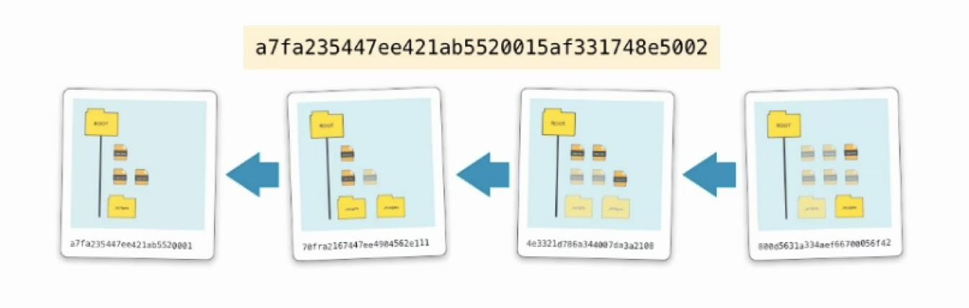
To “commit” (a verb and a noun)
40 character string hash reference for each commit.
Git reduces it to 7 characters in the log
Each commit references an older commit.

Slide 16


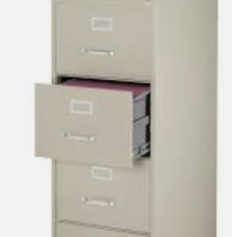
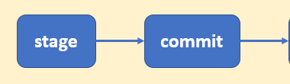
Key “git” concepts, visually...
Stage/ index
Working
directory
Repo

Slide 17
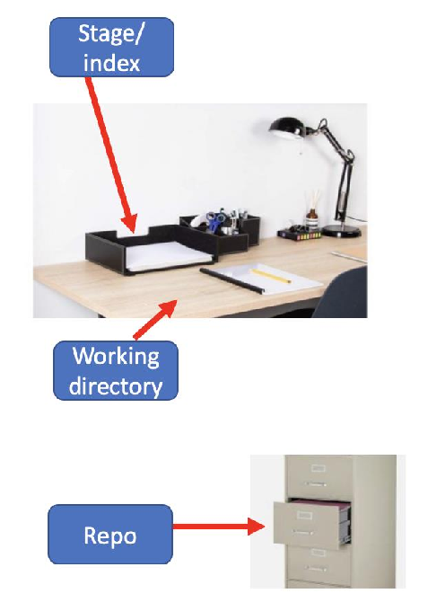
Key “git” concepts...
The files (in your working set) have 3 possible status:
Modified/Untracked (files are modified/new)
Staged (modified files are set aside)
Committed (staged files are safely stored into repo)
Another way to look at it: files belong to 3 virtual spaces:
Working Directory (untracked files, or modified files)
Stage (Index) (modified files are set aside here)
Repository (“the” project)
All on Local Machine

Slide 18
AGENDA
Version Control Git intro
GitHub intro

Slide 19

What is “GitHub”
“Web-based git repo hosting service”
(Git is command line tool)
Github is remote server, graphical, and ...
Flagship features: fork, merge, pull
Notes:
-server on the cloud

Slide 20
To let others see your work ...
git push
Copy your local, committed, repo to a remote location.
Can push either a whole project, or one branch
You could be “unable to push”. Solution:
Pull (fetch and merge), Fix conflict,
Push again
Synching local machine with remote

Slide 21
What is “.gitignore”
This is a “hidden” text file at your top level
List of files (or file formats) you don’t want to include when you “push” to remote.
Some machines or programming languages have intermediate
or local config files others don’t need to see.
Examples: .DS_Store, *.class, *.obj
Notes:
-i.e. have others do the compiling
-hidden folders should be visible → configure machine

Slide 22
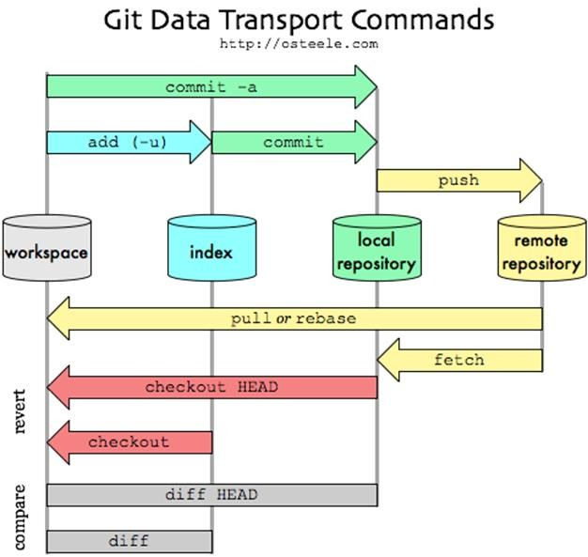
Recap Big Picture
(stage)
stage
commit
push

Slide 23
AGENDA
Demo:
Getting started locally

Slide 24
Demo
Follow the demo
Submit your final work

